Slide 1

CLINASSIST AI
ClinAssist AI: The Voice-First Clinical Assistant.
Transforming clinician-patient interactions into structured intelligence.
Presented by Break4th

Slide 2
Problem Statement:
Healthcare professionals spend a significant amount of time on documentation instead of direct patient care. Studies show that doctors can spend up to 40% of their time writing notes, updating records, and handling administrative tasks.
Healthcare Challenges
Doctors' Time
Patient Focus
Many doctors spend excessive time typing notes, which detracts from their ability to engage directly with patients during consultations (possibility to miss symptoms) (Delayed Patient care)
Increased administrative burdens lead to reduced focus on patient care, making it difficult for doctors to build meaningful connections.
Missed Symptoms
Communication Issues
Important symptoms are sometimes overlooked due to the overwhelming amount of information doctors manage during appointments and documentation.
Patients often struggle to articulate their symptoms clearly, contributing to misunderstandings and missed opportunities for effective treatment.
Access to Medication
Conclusion
Medication access can require extra time and travel, which complicates patients' ability to adhere to treatment plans effectively.
Overall, these challenges highlight the need for innovative solutions that streamline processes, enhance communication, and improve patient care.

Slide 3
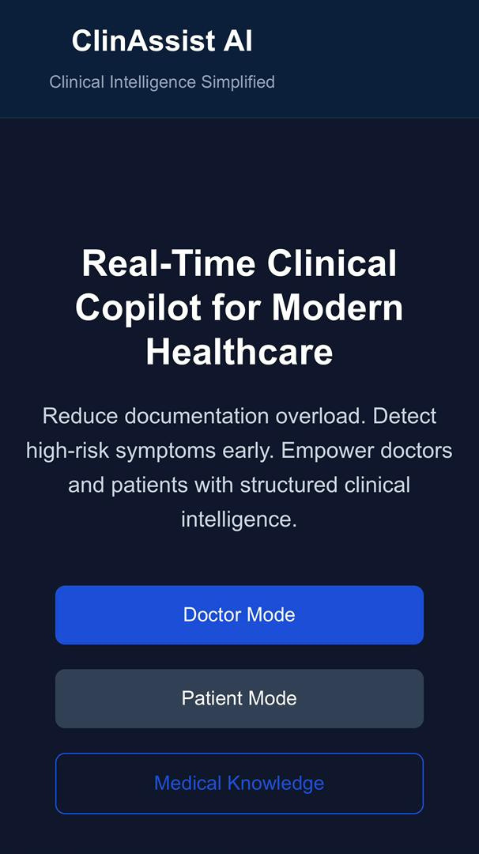
A Smart Assistant
For Doctors and Patients
ClinAssist AI is a web-based platform designed to listen and read patient symptoms, organizing medical information instantly while alerting doctors to potentially risky conditions.
  Input Versatility: Supports both voice and text inputs to accommodate different clinical environments.
  Privacy First: Secure standalone EMR built on cloud-based Firebase infrastructure

Slide 4
Focus on Patients
Streamlined Consultations
Doctors can simply speak or type during consultations, allowing for more focus on patient interaction and reducing administrative burdens.
Enhancing Doctor-Patient Interactions with ClinAssist AI
Automated Documentation
ClinAssist AI creates structured medical notes automatically, enabling doctors to maintain accurate records without the distraction of manual entry during visits.
SOAP Framework
The system categorizes information into Subjective, Objective, Assessment, and Plan, ensuring clear communication and organized documentation for effective patient care.

Slide 5
Empowering Patients
Home to Clinic Care
Medication Delivery
Patients can describe their symptoms from the comfort of home, making it easier to communicate with healthcare professionals.
ClinAssist AI allows patients to request medication delivery to their homes, providing convenience and saving valuable time.
Generate Summary
Book Appointments
The platform generates a summary of the patient's symptoms that can be sent directly to their doctor for review.
Patients can easily book appointments through ClinAssist AI, streamlining access to healthcare services and reducing wait times.
Choose Payment
Pharmacy Integration
Patients have the flexibility to choose payment options upon delivery, making the process more accessible and user-friendly.
ClinAssist AI improves access to care by reducing pharmacy queues and enhancing communication between patients and healthcare providers.

Slide 6
Business Potential
ClinAssistAI operates as SaaS targeting:
Revenue Model
  Hospitals
  Clinics
Business-to-Business (B2B) Model:
ClinAssist AI operates through paid partnerships with hospitals and pharmacies, enabling institutions to integrate the platform into their clinical workflows. By leveraging AI-powered triage, advanced risk ranking, and automated SOAP documentation, healthcare providers improve operational efficiency and gain a competitive advantage through faster patient prioritisation and streamlined consultations.
At the same time, patients benefit from reduced waiting times, quicker medical responses, and more coordinated care delivery, creating value for both healthcare institutions and the communities they serve.
Market Opportunity
  Growing demand for AI in healthcare
  Increasing documentation burden on clinicians
Product Scalability
Technical Scalability
Functional Scalability
  Cloud-based infrastructure (Firebase Authentication, Firebase Database)
  Automatic scaling of users and storage
  No physical servers required
  Advanced Risk Ranking (from High risk to Low risk) with color coded alerts.
  Download digital reports (PDF)
  Automated SOAP documentation generation
  Appointment booking

Slide 7

While many AI tools struggle with the friction of integrating into legacy systems, ClinAssist AI is built as a standalone, sovereign EMR. We provide a complete, 'out-of-the-box' digital solution for clinics that want to modernize instantly. Because we host the entire journey—from the patient’s first voice note at home to the final color-coded risk assessment in the doctor's office—clinics can modernize their entire workflow instantly, without the technical debt of traditional software.
What Is Our Future?
Unlocking potential for better healthcare solutions today

